Slide 1
Teaching with AI Enhancing Course Content and Supporting Preservice Teachers Responsible Implementation
Jennifer Garrette Lisy, Ph.D.
Amy Wolfe, Ph.D.
Kimberly Ciroli, MS
OCTEO October 12, 2023
Image Created by Bing Image Creator

Slide 2
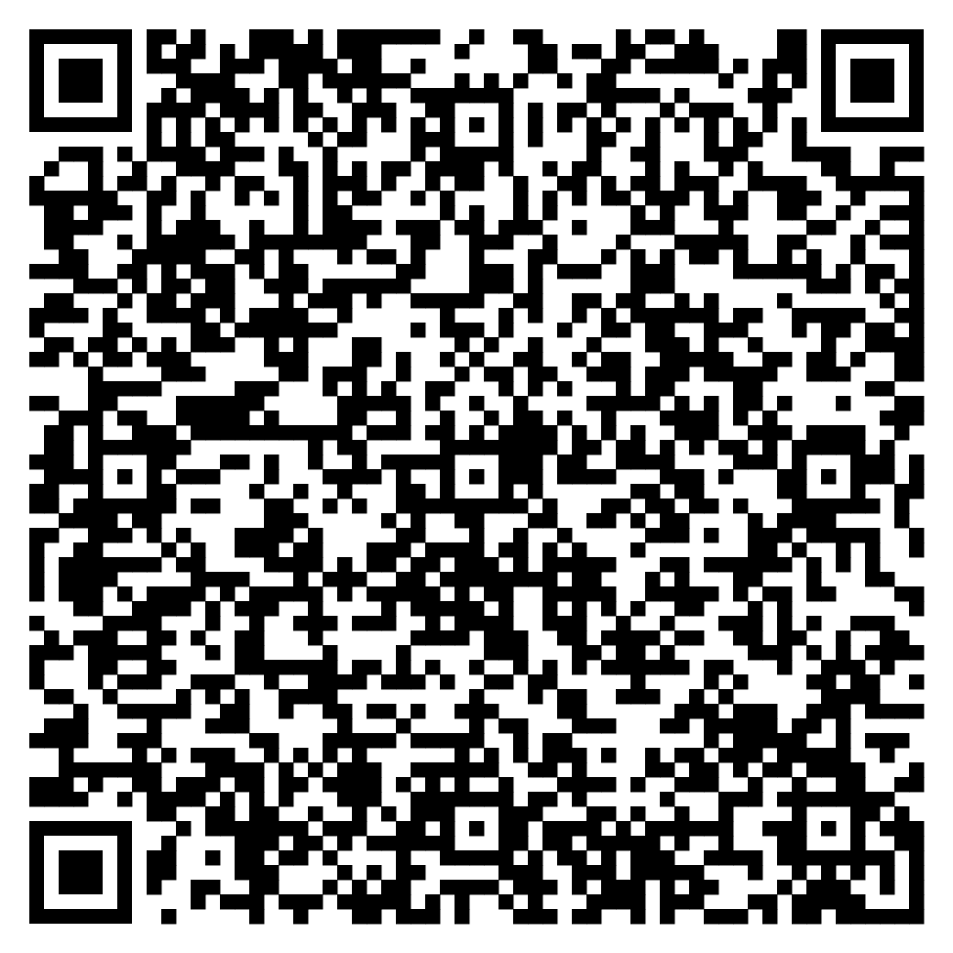
https://tinyurl.com/octeoAI23

Slide 3
Outcomes
By the end of this presentation, participants will be able to:
Explain at least two ways they could use AI to make their job as a professor easier.
Identify at least two ways they could have their preservice teachers use AI.
Describe some of the limitations and ethical concerns about AI use in education.

Slide 5
Professor Uses
Design lessons
Create assessments
Write drafts of documents
Generate hands on activities for classroom use based on course objectives

Slide 6
Create classroom materials
Prompts to have students practice creating assessments
Case studies to practice identifying the next steps in instruction
Discussion questions about short articles

Slide 7
Assessment Course

Slide 9
Case Study Directions
Read your case study with your group
Be ready to share what the class in the example is doing
Describe the Science and Engineering Practices (SEP), Crosscutting Concepts (CCC), and Disciplinary Core Ideas (DCI) that are woven throughout.
Why would these strategies support your student?
How could you incorporate these strategies into your classroom?
What are the big takeaways?

Slide 10
Students analyzed these profiles, identified the stage of word reading development, and the next steps in instruction.

Slide 11
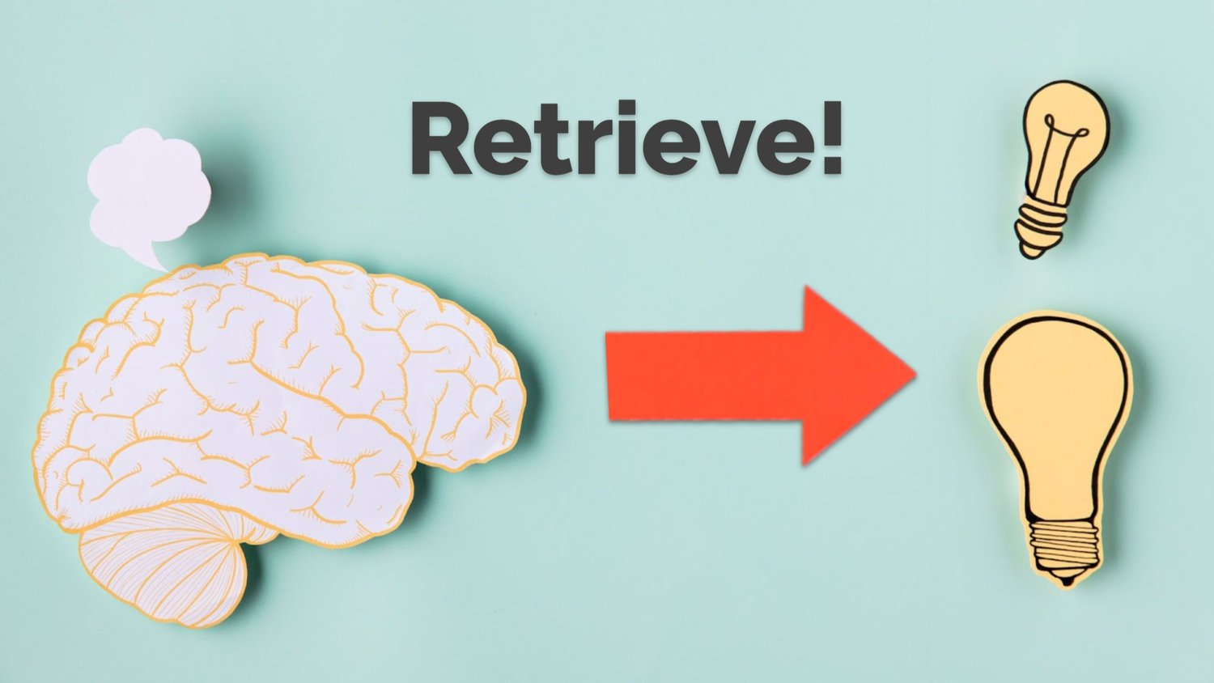
To create formative assessments
Retrieval practice strengthens memory and helps students flexibly apply what they learn.
https://www.google.com/url?sa=i&url=https%3A%2F%2Fwww.retrievalpractice.org%2Fwhy-it-works&psig=AOvVaw0YBtqtgjpvIT9yrLydQuR6&ust=1697146775902000&source=images&cd=vfe&opi=89978449&ved=0CBAQjRxqFwoTCMjD18f67oEDFQAAAAAdAAAAABAE

Slide 12
Creating Formative and Summative Assessments
Write 6 multiple-choice questions about using close reading in an elementary school classroom.
Examples of whole language classroom practices
Examples of structure literacy classroom practices
Examples of standardized and non-standardized tests

Slide 14
To write drafts and content
Brainstorm titles for presentations
Write emails and letters
Draft abstracts

Slide 15
What are tedious assignments that you create as a professor that AI could support?

Slide 16
Student Use
Generating hands-on activities based on content standards and/or student objectives
Creating an outline for a paper
Differentiating lesson plans for a specific disability
Personalized Tutor
can answer questions/give feedback

Slide 17
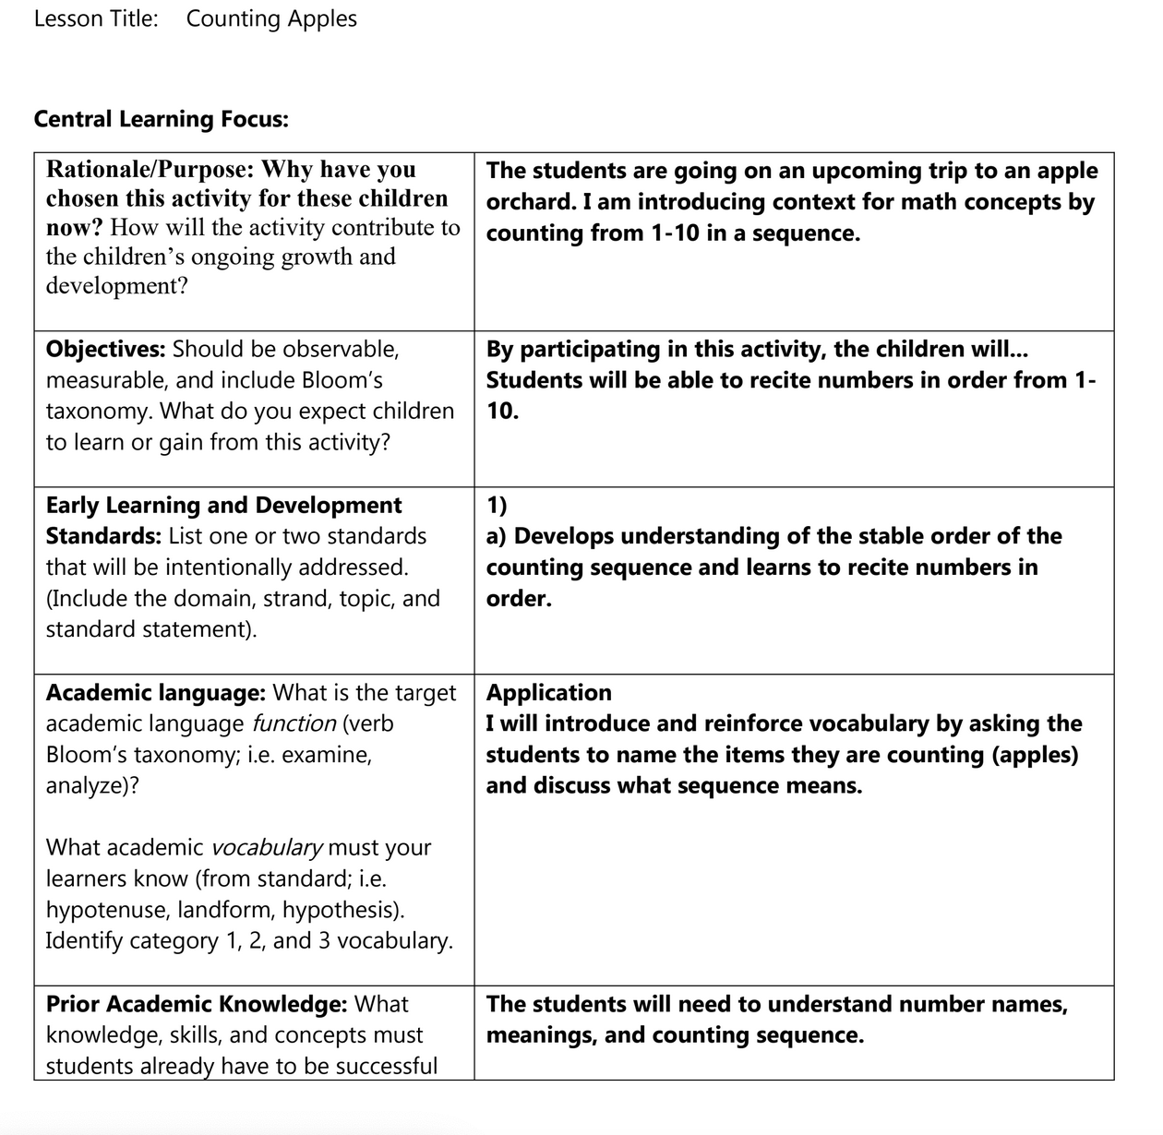
To help with writing lesson plans and creating assessments
BEFORE
AFTER

Slide 18
Candidate reflections on AI use in lesson planning after first attempt
Positives
Helped with challenging sections
Helped think about DAP
Helped make it sound academic
Helped getting un-stuck
Improved language/ vocabulary
Made lesson more formal
Saves time
Helped see what they missed
Another perspective
Fast feedback
Can improve accessibility
Negatives
Free version isn't up to date on Early Learning Standards
Doesn't know the students in the class
Not your own ideas
Takes away creativity
Creates dependency on technology
Can be wrong
Gave suggestions for rationale
Goes off topic
Changes things I didn't want changed
Potential for abuse
People will get lazy

Slide 20
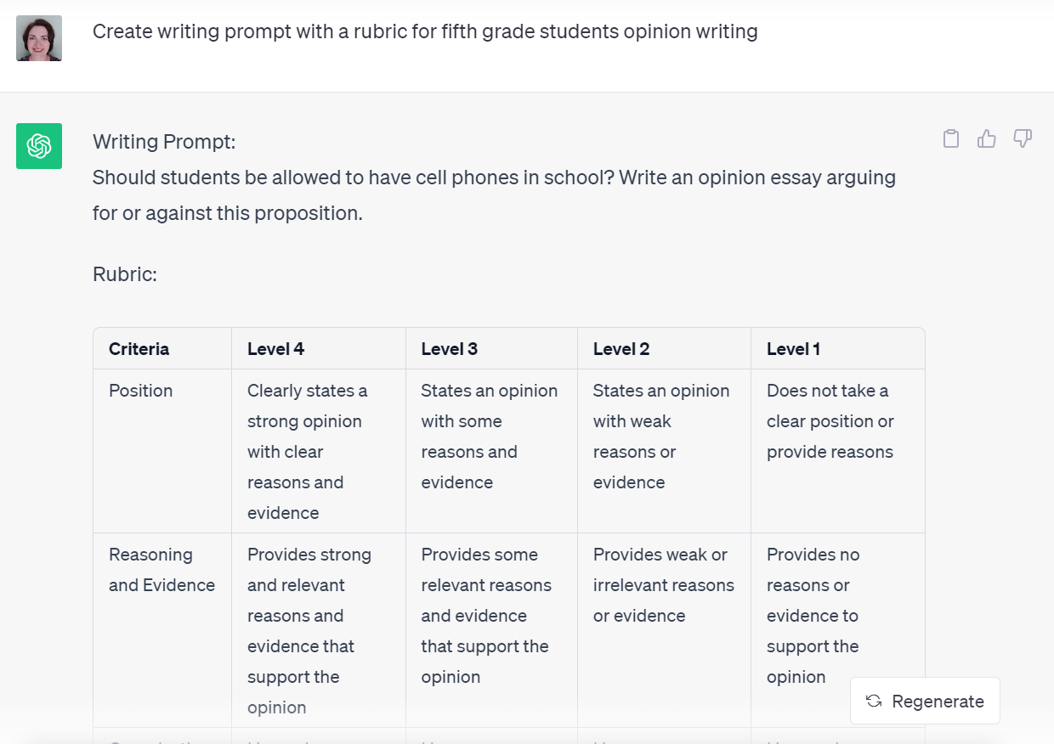

Slide 23
Differentiating Lessons for Specific Disabilities
Give me a differentiation for a child with autism with a lesson on blending phonemes
ChatGPT
Teaching phoneme blending to a child with autism may require a structured and visual approach to accommodate their unique learning needs. Here's a lesson plan tailored for such a child:
Lesson: Phoneme Blending for Children with Autism
Objective: To teach a child with autism how to blend phonemes to form words.
Materials:
Picture cards with simple CVC (Consonant-Vowel-Consonant) words (e.g., cat, dog, sun).
A visual schedule or visual support system.
Reinforcement tokens or preferred items (e.g., stickers, small toys, or snacks).
A quiet and distraction-free learning environment.

Slide 24
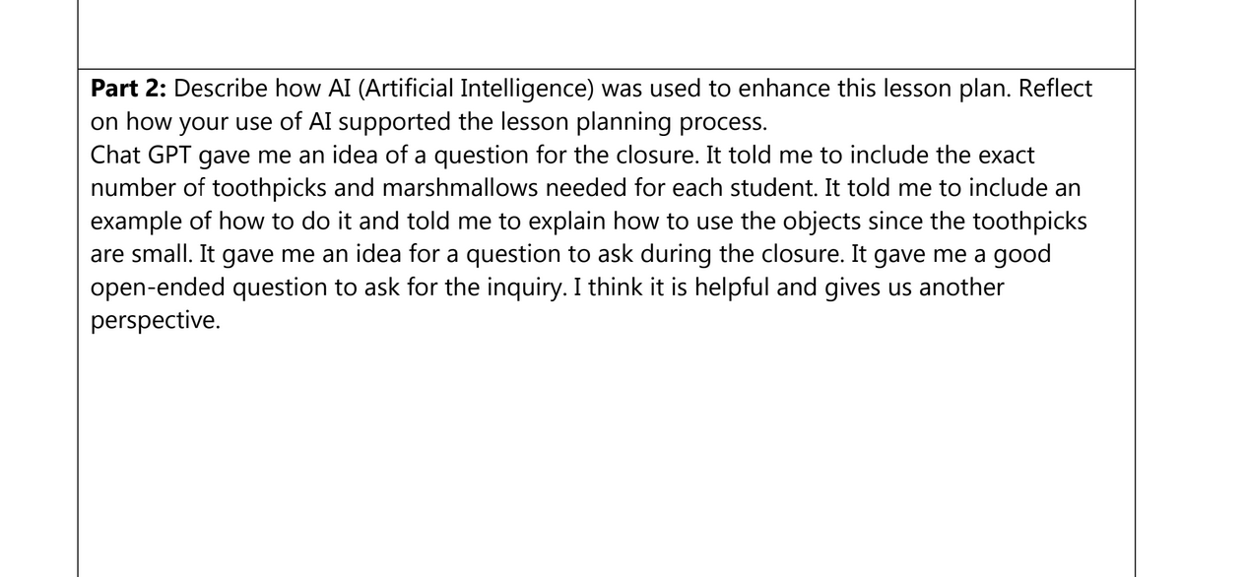
Supporting Student Use
Exposing undergraduate preservice teachers to AI is not enough
Must evaluate the reliability and validity of the resources created by AI

Slide 25
Dealing with AI in our assignments
AI Checkers are not effective
Changing to have them make connections to class lectures and personal experiences
Put your assignments into AI to see what the output looks like

Slide 26
Sample of candidate using AI inappropriately

Slide 27
AI Policy
Can be used for brainstorming or to help you revise existing work that you have written.
If you use AI, you must indicate what part of the assignment was written by AI and what was written by you.
No more than 25% of the assignment should be created with AI.

Slide 28
Sample AI quotation
Anytime you choose to use AI to assist you in an assignment, you must include an AI statement. This statement should be at the end of your document, identify the AI tool that was used, how the tool was used, and which parts of the assignment were generated by AI.
Sample AI quotation:
“The science of reading encompasses the multidisciplinary study of cognitive, linguistic, and neurological processes involved in comprehending written language,” (OpenAI, 2023).
Citation:
OpenAI. (2023). ChatGPT (Mar 14 version) [Large Language Model]. https://chat.openai.com/

Slide 29
Sample AI Statement for an Assignment
I used Chat GPT to help me brainstorm ideas for my paper about the Science of Reading. Once I had written my initial draft, I input it into Chat GPT and asked it to give me feedback to help me with revisions. I incorporated those revisions into my final piece.

Slide 31
AI Risks and Limitations
Can create false information
Potential to create deceptive content
Potential bias in its training data
Security risks from the data it is gathering

Slide 32
AI Hallucinations
May “create”
citations that do NOT exist
incorrect information
distorted images
nonsensical responses
https://www.aipathway.com/ai-hallucinations/
Notes:
Example from Katon about the incorrect APA Citation

Slide 33
AI Bias
Reproduces harmful bias from the training data
https://rjionline.org/news/understand-algorithmic-bias-in-journalism/

Slide 34
AI Ethics
All of the text, images, etc. created by AI are built on the works of people

Slide 35
How does this change our teaching?

Slide 37
Resources to check out
Podcast: Assignment Makeovers in AI

Slide 38
Contact Us
Dr. Jen Lisy
lisy@ohio.edu
Dr. Amy Wolfe
amy.wolfe@ohio.edu
Kimberly Ciroli
ciroli@ohio.edu

Slide 39
AI Risks and Limitations
Reliable research results
Knowing specific information about an individual class or person to give accurate information or accommodations

